Slide 1

Regulatory Compliance Leveraging Platform
Karthik padullaparty
Supervisors: Lech janczewski & Yun-Sing Koh
Mentor: Gabriel Akindeju

Slide 2
RCL – Company Overview
Business Technology Risks Management Consulting Practice
Offering services
Information Security Architecture
Governance, Risk and Compliance
Business Technology Vulnerability & Exposure Management
Business Information Security Incident Management
Notes:
RCL is a Busniness Technology Risks Management Consulting Practice.
With some of their services offered are
Information Security Architecture
Governance, Risk and Compliance
Business Technology Vulnerability & Exposure Management
Business Information Security Incident Management

Slide 3
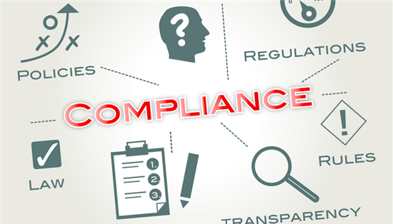

Business Problem
Notes:
For most businesses the biggest recurring cost is the compliance.
The bigger the company the more the standards they have to comply with and the more they have to spend. What is the best way to tackle this issue from a business point of view, which will appeal to most CEO’s.

Slide 4

My Project
Solution
Financial Institutions
Top 3 standards
Notes:
Develop a platform that saves companies from spending a minimum of $500k every year to be compliant with industry specific standards.
Instead of trying to attack all the industries at once, I have chosen to look at Financial Institutions first and create a working prototype.
There are also a lot of standards, so it was easier to focus on the top three standards, that these institutions spend money on.

Slide 5

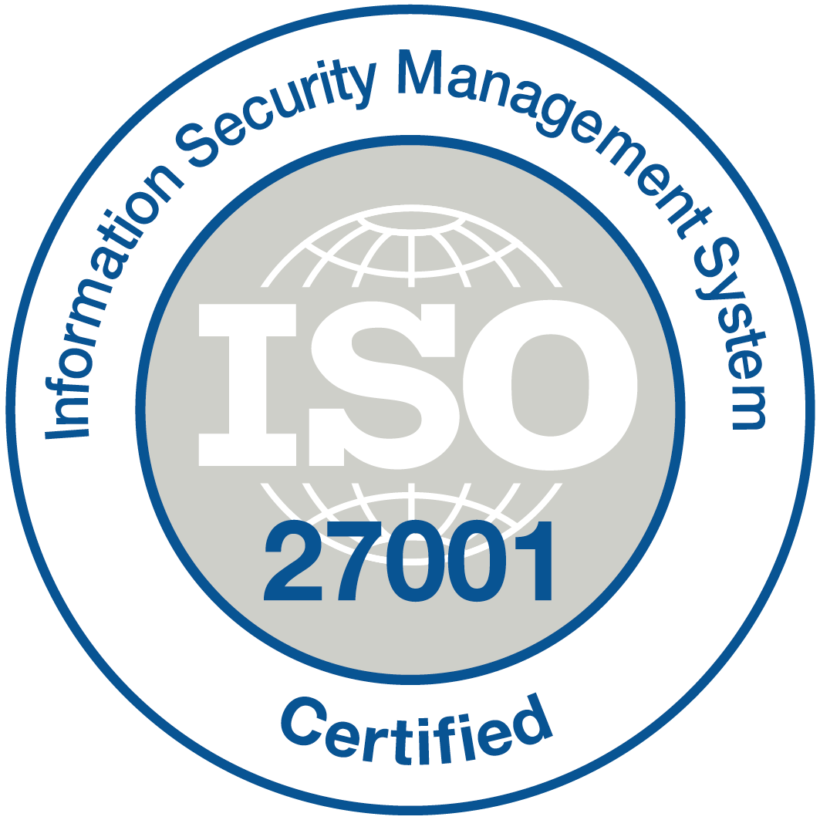

Top 3 Standards
Payment Card Industry Data Security Standard (PCIDSS)
Sarbanes-Oxley 404 (SOX)
ISO 27002
Notes:
Basically all banks have EFTPOS and Credit Cards – all these cards have data on them.
They need security standards to protect this data so its very key.
Confidentiality of credit card information stored and used by merchants.
Sox
Privacy and integrity of financial data in publicly traded corporations. Operational processes are documented and practiced demonstrating the origins of data within the balance sheet.
All business that trade with the USA are supposed to follow this standard, so another key standard.
ISO
Specifies 133 controls that can be used to reduce security risks.
Privacy and security standards are all based of these 133 controls.
By looking at this standard I would be able find some commonalities between the three standards, and eliminate any duplicates I might have.

Slide 6
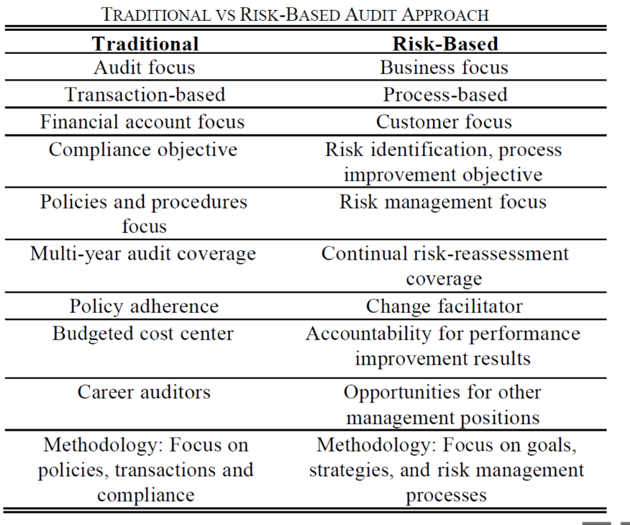
Auditing Approach
Traditional
RBA (Risk based auditing)
Traditional vs RBA?
Notes:
Traditional = conducting tests to issue an opinion on the truth and fairness of the financial statements
These tests financial statements, tests on the amount balances of the accounts, and tests on the overall posting system of its accounts.
RBA changes the way internal auditors think and talk about risk. Instead of focusing on history, audit reports address the present and the organization's level of preparedness to deal with the future. RBA places an emphasis on risk-based internal audit reports rather than on traditional controls-based reports.
With a large shift towards technology, businesses follow risk-based auditing as this will ensure that they are volatile with their changes and do not have to spend large sums of money to change systems and other aspects of their business. Which is what I am implementing in this platform.

Slide 7
Related Works - Current Platforms
Strevus
Financial Standards
BitCoin and Digital Currency
KYC, AML etc
MetricStream
Any industry
RCL
Financial Standards
PCIDSS, SOX
Privacy of data
9300+ controls from 1200+ regulations
Notes:
Strevus enables organizations that currently trade or plan to trade in Bitcoin or digital currency the ability to maintain full compliance with existing KYC, AML, and Patriot Act requirements.
The platform helps customers navigate through the sea of regulatory compliance in today’s shifting landscape and deploy an effective solution that meets the unique challenges of each of the organisations.
developed a cloud app for Governance, Risk and Compliance. IT-GRC solution by MetricStream provides a few of the following capabilities:
Policy Management
Risk Management
Provides risk identification to mitigation and reporting.
Compliance Management
Provides with an excel sheet framework, not linked to any database.
My solution, somewhat similar to MetricStream but I will be focusing on providing guidelines for the company to make sure they are compliant with their chosen security standards.

Slide 8
My Solution - Platform
What is the purpose of this platform?
Key attributes
Data Inputs
Comparison Construct – (matrix)
Report
Integrity and Audit Trail
Time based Archiving
Notes:
What is the purpose of this platform?
Typical audit process is that the Auditor will generate an Audit Work-Programme based on a standard. This is used to perform an audit review
So, the system will be used to generate the Work-Programme and the outcome of the review will be documented against each Control Objective.
These documentations will enable the company to achieve their compliance.
To address this we need to have the following key attributes: -
Data Inputs – this is to allow the auditors to input comments, check the check boxes etc, require to complete the process
Comparison Construct – a matrix that will be comparing the various selected instruments and help with the reporting
Report – these reports are generated for the auditors, as well as simpler ones for the upper management.
Integrity and Audit Trail – this ties closely with the next bullet point, where the comments are only allowed to be edited and added within that financial period.
For example, all the reviews conducted this year will have comments that are added to that program and at the end of the financial year all the editing privileges are withdrawn
and they can only be viewed, so when the auditor conducts his investigation then he will be sure of the integrity of the reviews.

Slide 9
Current Progress

Slide 10
Matrix
Impact Zones | PCI DSS | SOX | ISO 27002
Leadership and high level objectives |  | - Define and manage service levels (16)
Audits and risk managements | Maintain a policy that addresses information security for all personnel (12) | - Develop and maintain policies and procedures (13) - Manage problems and incidents (20) | Security Policy (5) Information Security incident management (13)
Monitoring and measurement | Track and monitor all access to network resources and cardholder data (10) Regularly test security systems and processes (11) | - Manage Changes (15) | Organisation of Information Security (6.1)
Technical security | Firewall Configuration (1) | - Ensure systems security (18)
Physical and Environmental protection | Restrict physical access to data (9) |  | Asset Management (7) Physical and Environmental Security (9)
System continuity |  |  | Business Continuity management (14)
Human resources management |  |  | Human Resources Security (8)
Operational management |  | - Manage operations (22) | Communications and Operations Management (10)
System Hardening through configuration management | Use of anti-virus (5) | - Install and test application software and technology infrastructure (14) - Manage the configuration (19)
Records management | Assign a unique ID to each person with computer access (8)
Systems design, build and management | Develop and maintain secure systems and applications (6) | - Acquire or Develop -Application Software (11)
Acquisition or sale of facilities, technology, and services |  | - Acquire Technology Infrastructure (12) | Information System acquisition, development and maintenance (12)
Privacy protection for information and data | Not using vendor-supplied defaults for system passwords (2) Protect stored cardholder data (3) Encrypt transmissions of data across open, public networks (4) Restrict access to cardholder data by business need to know (7) | - Manage data (21) | Access Control (11)
Compliance and Governance Manual of Style |  |  | Compliance (15)
Third Party and supply chain oversight | Shared hosting providers must protect the cardholder data environment (A.1) | - Manage third-party (17) services | Organisation of Information Security (6.2) Communications and Operations Management (10.2)
Notes:
This matrix is the foundation for the backend of the platform, in my report I had addressed this from a very high level, classifying some of the control objectives into 15 impact zones.
Each instrument address some or all of these impact zones and each of the controls listed are more detailed.
In the system, this matrix will be bringing together the different instruments which will enable report creation for the auditors.
Each impact zones, address a small aspect of the information system that is handling this data. For example if we look at the first one – “ Leadership and high level objectives” –
Only Sox has a specific control that addresses how an organization meets the functional and operational expectations. Other instruments, will have only a certain alignment that address this impact zone, but not an entire objective.
Similarly privacy protection for information data which is the key impact zone for all these standards, you can see they all have atleast one control objective. ISO talks about Access control, so how the data is accessed, similarly SOX talks about managing data, PCI DSS obviously has more control objectives, because cards are the most vulnerable way of data loss.

Slide 11
Example of base control and alignment`
3.1 Keep cardholder data storage to a minimum by implementing data retention and disposal policies, procedures and processes that include at least the following for all CHD storage: • Limiting data storage amount and retention time to that which is required for legal, regulatory, and business requirements • Processes for secure deletion of data when no longer needed • Specific retention requirements for cardholder data • A quarterly automatic or manual process for identifying and securely deleting stored cardholder data that exceeds defined retention.
Base control
Alignment
Notes:
The above is an example of a PCI DSS control, there are more than 200 controls in each of the instruments. Each has a base control and then an alignment.
Some of the alignments are more useful than others, in some cases it is the same base control, however the alignments might vary slightly.
I am currently in the process of defining the base controls and alignments for each of the instruments. These will be the entries into the different tables in the database.
Each instrument will have its own base control and alingnments.

Slide 12
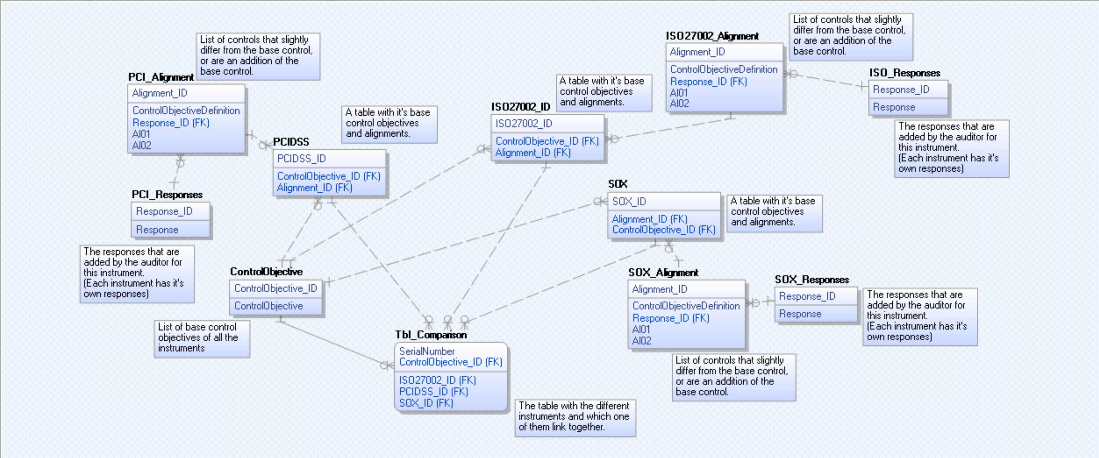
ERD Design
Notes:
Taking the matrix as the basis, I have created this ERD as a rough plan of how my backend will end up looking like.
The base control objectives will be listed in the ControlObjective table, since there are few objectives which are common for all the instruments. There is an estimation of more than 300 entries.
Although the base control is common to the instruments, they all have some alignments that differ from each other, so each of these will be listed in their own tables with a one to many relationship with the instrument tables.
You will notice there are three response tables, each of the tables will have responses that the auditors have inputed into the system. (There is an attribute missing which is the date/time) – to help with the time based archiving as well
As the integrity of the data.
Finally a Comparison table, which is a fact table, with information that can be extracted for reporting purposes in the front end. The comparison table has all the selected standards within and will give a work program that will link all the instruments together.

Slide 13

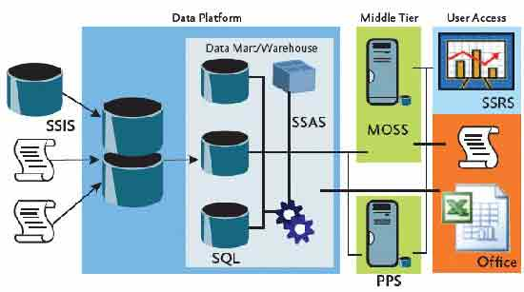
Technology
Platform – Web Based
HTML/PHP for the frontend
SQL Server for the backend
Notes:
To incorporate the key attributes, as well as creating a work database by using the ERD, I will be using MS SQL Server as the backend of the platform.
I will be automating data inputs and report retrieval by carrying out ETL using SSIS, SSAS and SSRS.

Slide 14
What’s Next?
Finalise the base controls and alignments
Set up MS SQL Server
Use SSIS to create a data warehouse
Use SSRS for reporting
Will eventually be used to report on the front end of the system
Front end programming
Prototype (optional)

Slide 15
Timeline
Semester 1 – 1st half
Identify appropriate industry
Semester 1- 2nd half
Analyse the selected standards
Semester 2 – 1st half
Finalise commonalities documentation
Identify & select 3 standards
Create a brief
Document commonalities
Categorise commonalities and differences
Semester 2 – 2nd half
Finalise the database structure.
Create leveraging matrix
Have some database structure in place
Create the front end of the platform.
Design the prototype (optional)
0%
25%
60%
100%
Notes:
1st Semester – 1st half –
2nd half –
2nd semester and holidays
2nd half -
My timeline is subject to change – depending on the time constraints.

Slide 16

Questions?
Thank you!

